Slide 1

Project Statements and Explanations

Slide 2
Evaluation of neurosurgery skills on hands-on skills training modules

Slide 3
Objective
Build a software based real-time Evaluation & Assessment system to grade the trainee/trained neurosurgeons based on their surgical skills

Slide 4
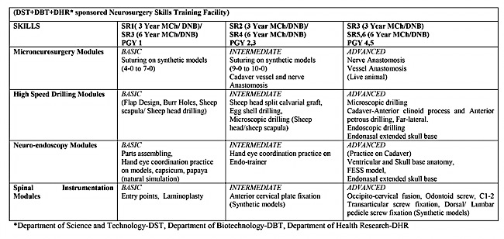
Modules to work on
Neuro-endoscopy Module
Micro-surgery Module
High Speed Drilling Module

Slide 5
Modified OSATS-NETS Evaluation Criteria
S No. | Criteria | Evaluation Parameter |  | 1 | 2 |  | 3 | 4
1 | Eye hand Coordination | -Handling of suture, instruments (Needle holder, tooth forceps, drill, endoscope, grasper) -Depth perception (Under magnification) |  | -Continuous struggle throughout the activity | -Frequent loss of coordination -Able to use microscope/ endoscope well but poor instrument manipulation) |  | -Grossly smooth coordination using low magnification -Able to use microscope/ endoscope and instruments but coordination still lacking while using higher magnification | -Good Coordination under high magnification
2 | Instrument tissue manipulation | -Tissue handling under magnification with various instruments -Appropriate pressure and force -Confrontation with neighboring objects (Repeated puncture) |  | -Severe surrounding and focal tissue damage (Animate) irregularity/ striking objects in trajectory (Inanimate) | Surrounding tissue intact but significant focal site injury (Animate) occasional irregularity of instrument manipulation (Inanimate) |  | Surrounding tissue clean but mild focal erythema or overlapping margins/ instrument manipulation smooth but slow and non confident | Clean focal and surrounding tissues and smooth manipulation
3 | Dexterity | -Tremors/ jitteriness -Therblig (Intraoperative elemental motion) |  | Irregular therblig/ tremors/ jitteriness throughout the activity and frequent unnecessary movements -Unable to assemble instrument and name parts of instruments | Well versed with instruments but unsteady in its handling |  | Well versed with instruments and steady handling but unable to perform examiner directed procedures with it | Good dexterity and completely at ease to perform examiner directed procedures
4 | Flow of procedure | -Time management during activity -Total duration in task completion -Unnecessary delays in inter or intra therblig |  | Unable to complete tasks and its stages | Considerable delay in completing the stages of the tasks assigned but is able to complete the task in a reasonably delayed time |  | Completing the tasks in assigned time | Completing the task well before the assigned time
5 | Effectualness | Evaluation of end result on predefined criteria* for -Micro-suturing or -High speed drilling or -Neuro-endosocpy |  | Less than one fourth criteria fulfilled | Nearly half criteria fulfilled |  | Nearly three fourth criteria fulfilled | Nearly all criteria fulfilled
Criteria for effectualness* A. Microsuturing: -Margins (Overlapped/ loose/apposed); -Inter-sutural distance (Equal/ Unequal); -Sutural distance on both sides of the incision (equal/unequal); -Angulation between suture and knot (Near perpendicular-⁻ Yes/No) |  |  | B. High Speed Drilling: -Drilled burr hole (cylindrical versus irregular shape viz. cone, serpiginous) -Intactness of dura/ inner core of egg/ periosteum on other side of bone -Drilling within stencil marked area -Approximation of straight movement/ direction |  |  | C. Neuroendoscopy: -Final position of pegs/ rings ≥3 pegs slipped 2 pegs slipped 1 peg slipped All pegs in place

Slide 6
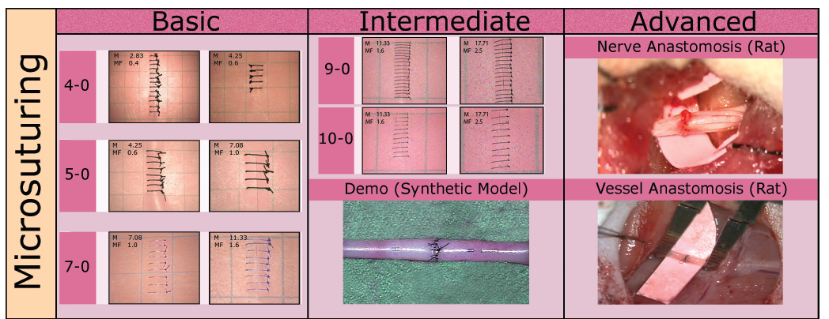
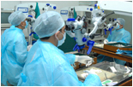
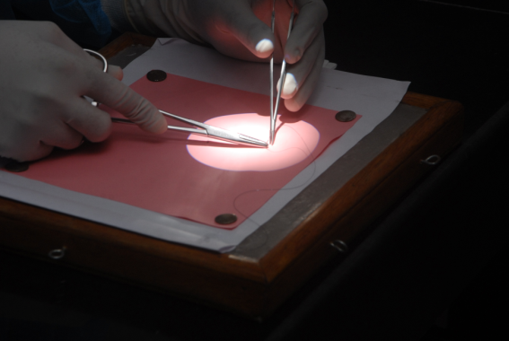
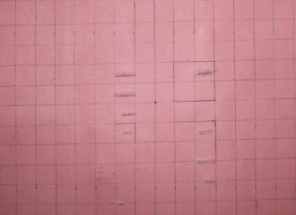
Standardization: Micro-suturing
I. Methodology: Skills Training
II. Video Archival: At Defined Recording Parameters
Basic Micro-suturing Training on Synthetic Material
Suture | Material | Magnification
4-0 | Silk | 2.83
 |  | 4.25
5-0 | Silk | 4.25
 |  | 7.08
Advanced Micro-suturing Training on Synthetic Material- Evaluation
7-0 | Monofilament | 7.08
 |  | 11.33
9-0 | Monofilament | 7.08
 |  | 11.33
 |  | 17.71
10-0 | Monofilament | 11.33
 |  | 17.71

Slide 7
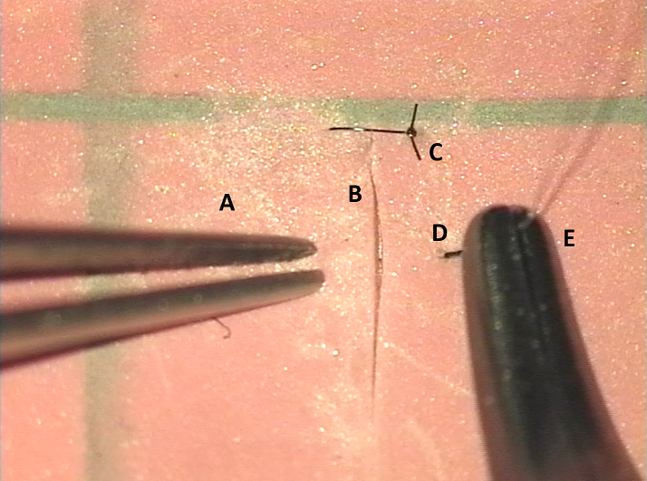
Micro-suturing- Tool tracking

Slide 8
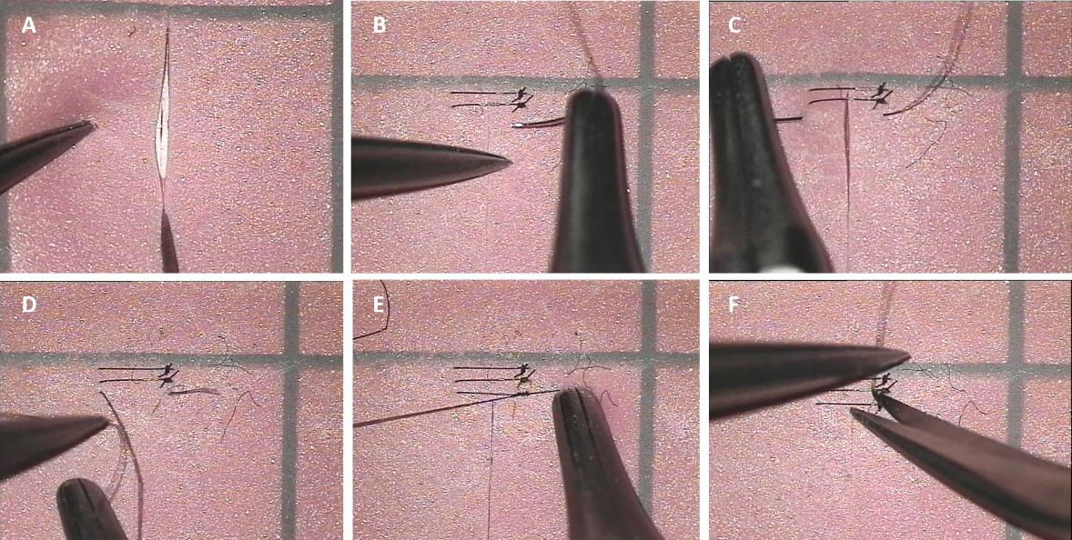
Micro-suturing Activity recognition
Micro-suturing training task, (A) Sheet incision, (B) Needle insertion, (C) Pulling the needle and suture, (D) Suture throwing to make turns, (E) Tying the knot, (F) Cutting the suture.

Slide 9
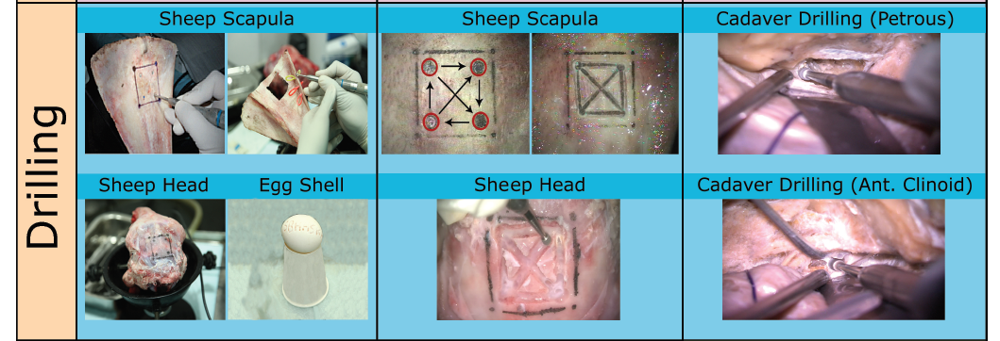
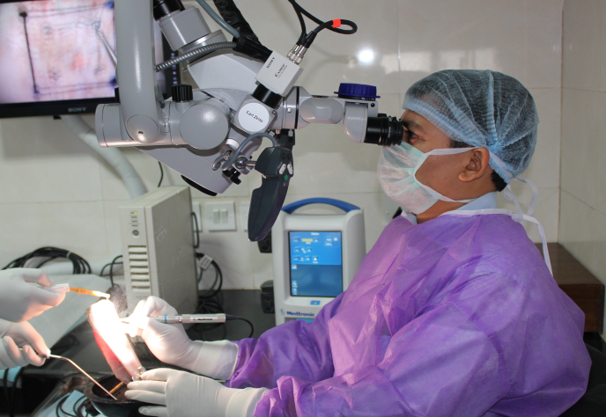
Standardization: High Speed drilling
Methodology:
Skills Training
II. Video Archival: At Defined Recording Parameters
Basic Drilling
Bit-type | Magnification
M8 | 2.83 (0.4)
Advanced Drilling
AM8- Diamond | 2.83 (0.4)

Slide 10
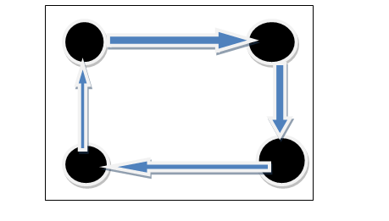
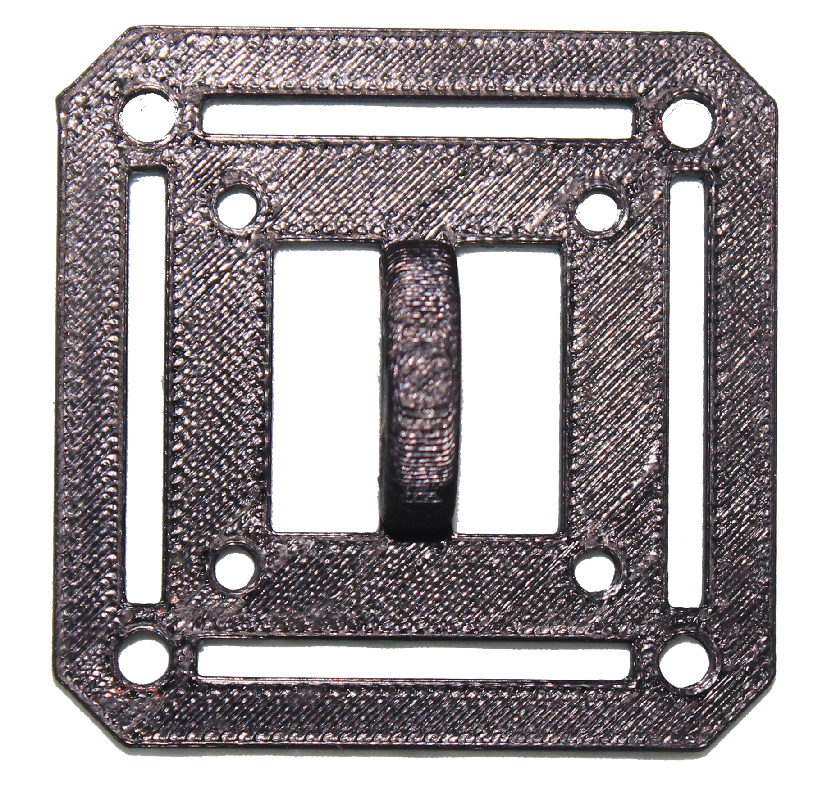
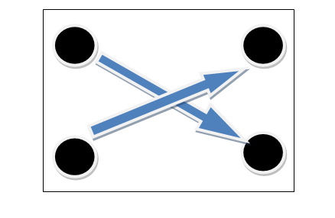
High-Speed Drilling

Slide 11
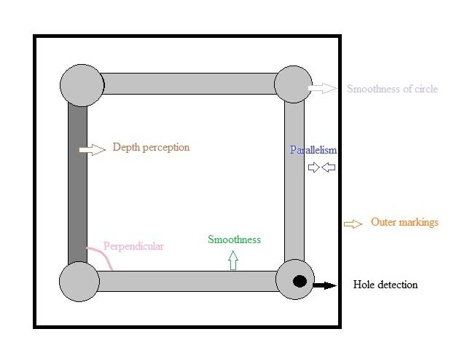
High-Speed Drilling (Effectualness)

Slide 12
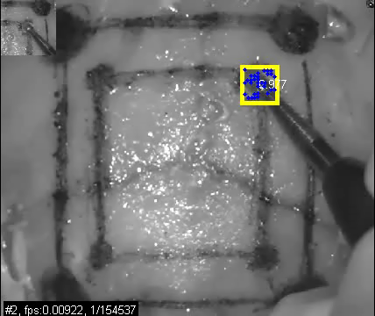
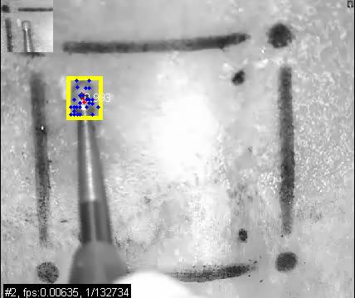
High-Speed drilling (Tool tracking)

Slide 13
High-Speed drilling (Activity Recognition)
Circular/ Semicircular movement- Top left, top right, bottom right, bottom left
Linear movement- top, right, bottom, left
Slippage of drill for burr holes
Slippage of drill for straight lines
Irrigation

Slide 14
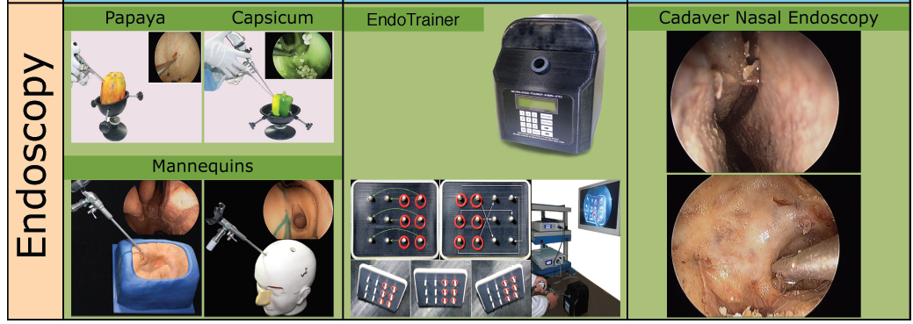
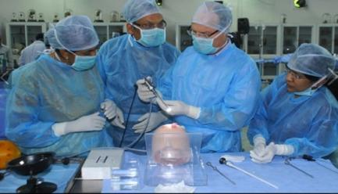
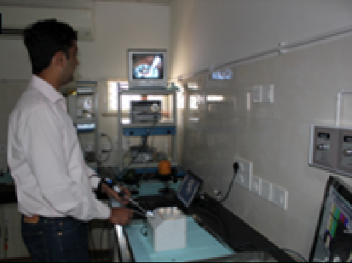
Standardization: Neuro-endoscopy
Methodology:
Skills Training
II. Video Archival: Endo-trainer
Particulars | Dimension
Forceps - Total length - Working Length | 160mm 140mm
Peg board area of manipulation | 60X40mm
Collars Pegs | 20mm 15mm
External box | 160X160X160mm

Slide 15
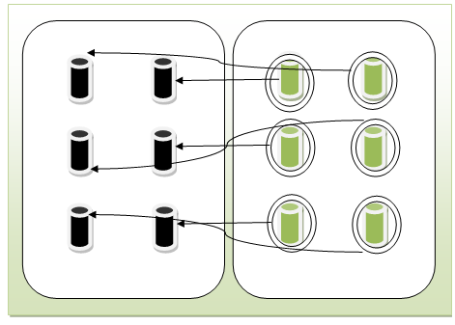
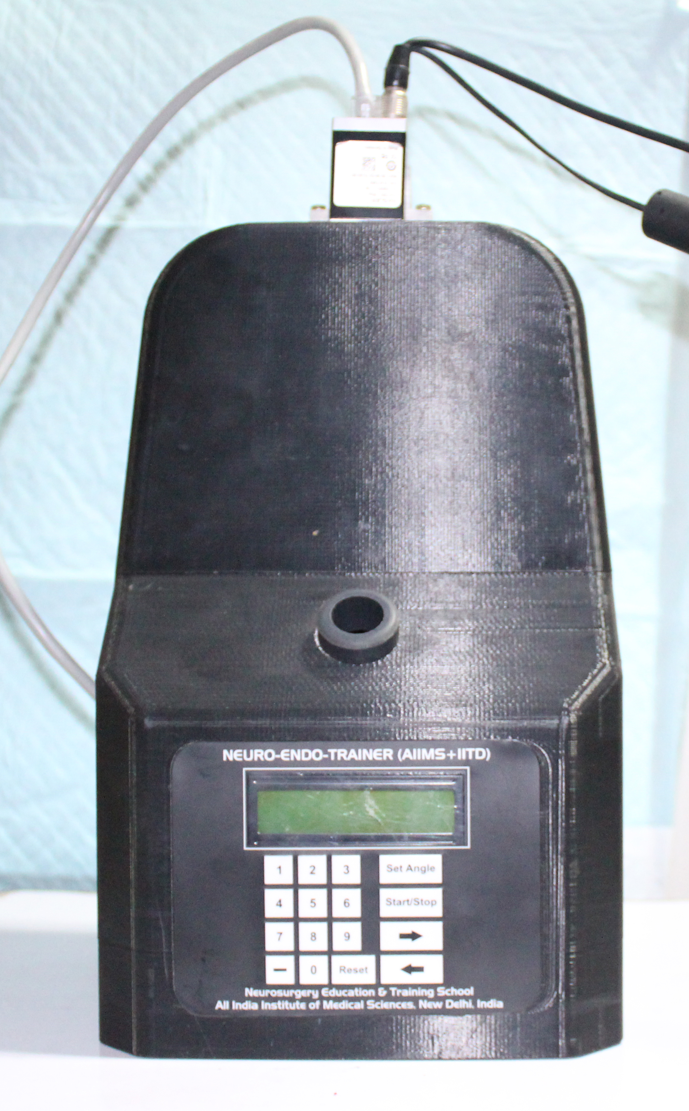
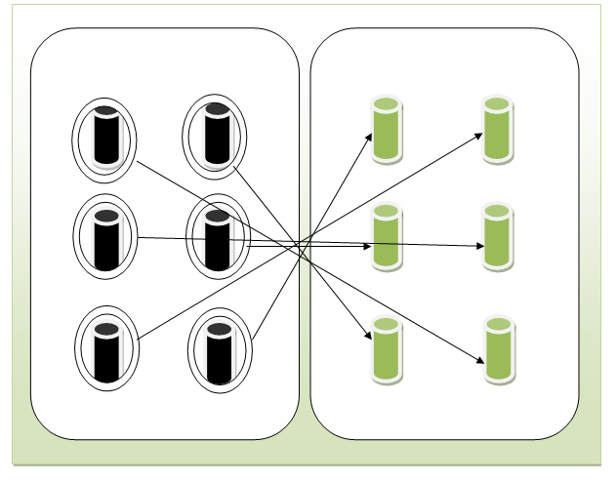
Neuro-Endoscopy

Slide 16
Neuro-Endoscopy (Activity Recognition)
Picking at peg number
Moving from peg number to peg number
Stationary

Slide 17
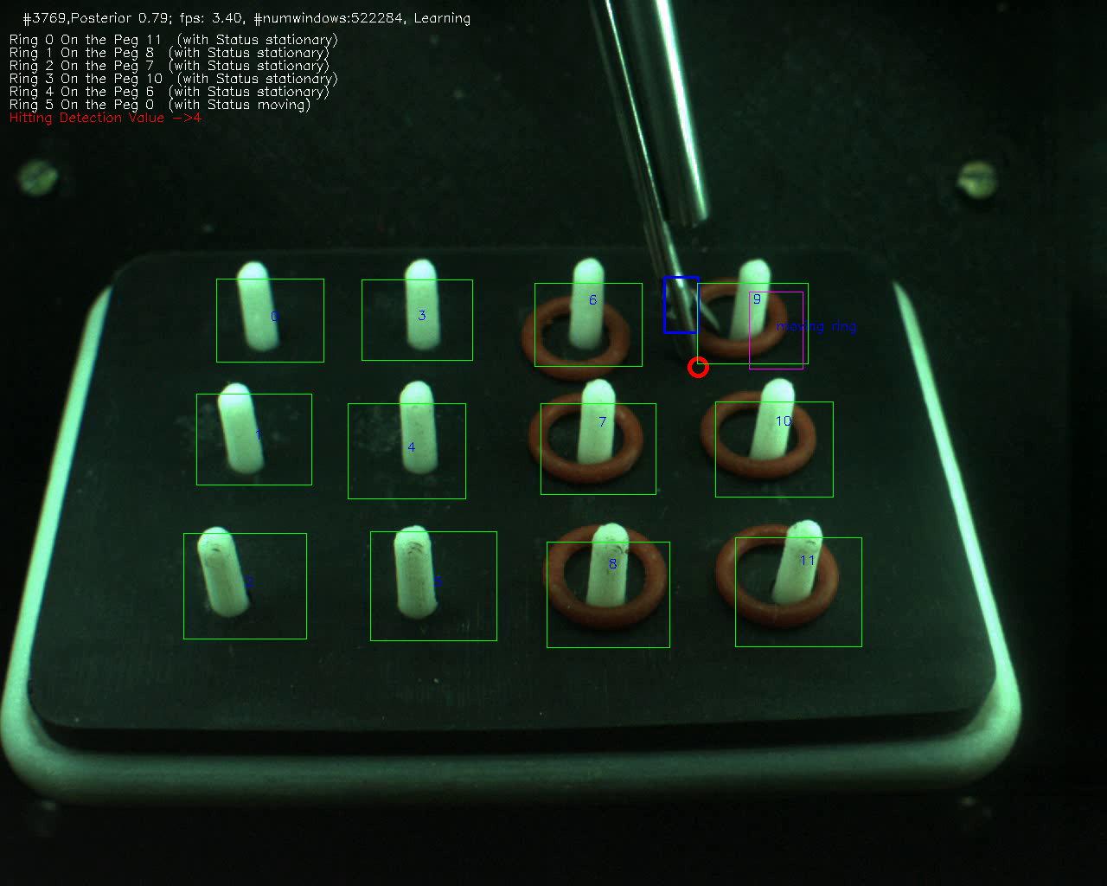
Neuro-Endoscopy (Tool tracking)

Slide 18



Thank You

